Slide 1


Slide 2




Slide 3
sit on the sofa
play video games
eat vegetables
drink fizzy drinks
drink juice
do exercise

Slide 4
What can you do
if you want to be healthy?

Slide 5
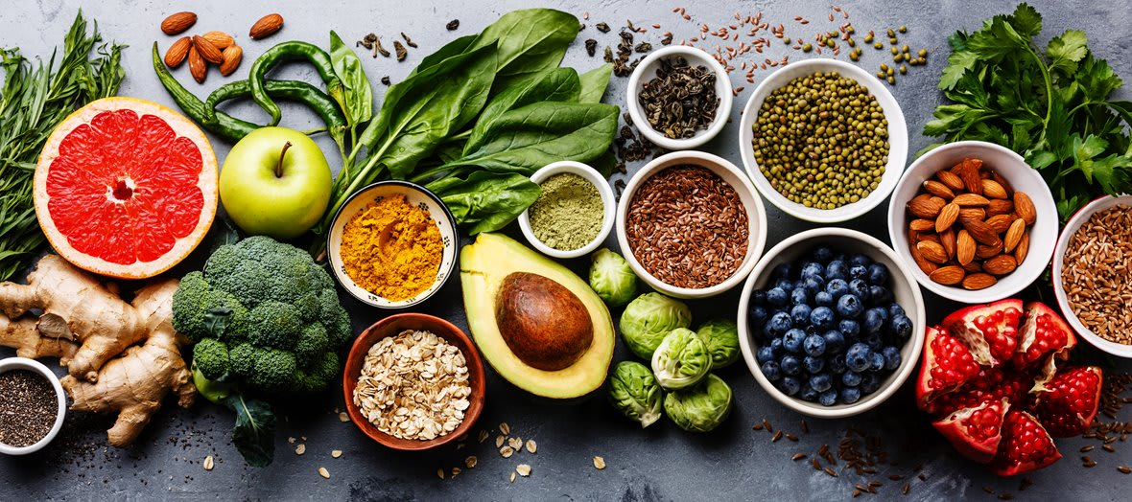
UNIT 5:
FOOD AND HEALTH
Lesson 4
VOCABULARY AND LISTENING

Slide 6
Activity 1:
1. active 2. hungry
3. healthy 4. fit
5. tired

Slide 7
News words
1. active (adj) /ˈæk.tɪv/
→ E.g: An active person does a lot of activities.
2. fit (adj) /fɪt/
# unfit (adj) /ʌnˈfɪt/
→ E.g: A fit person exercises a lot.

Slide 8
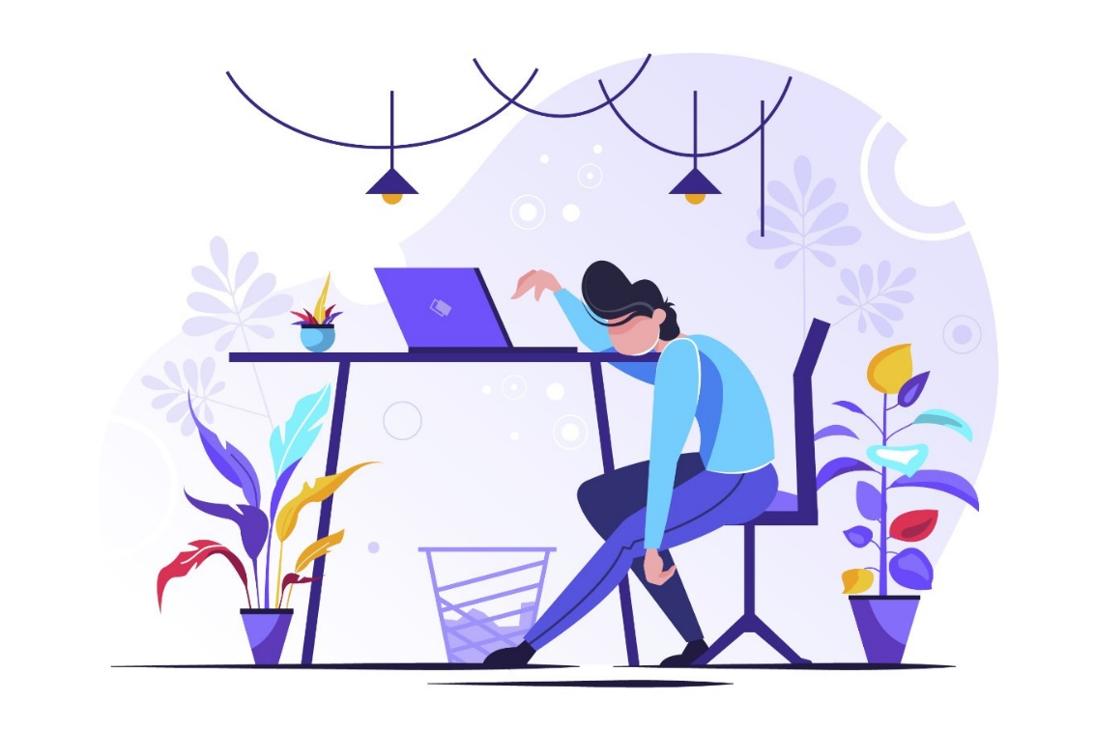
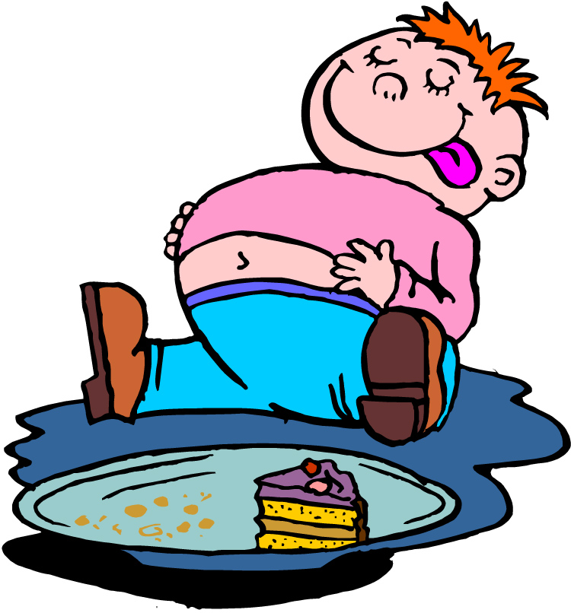
News words
3. tired (adj) /taɪrd/
4. full (adj) /fʊl/

Slide 9
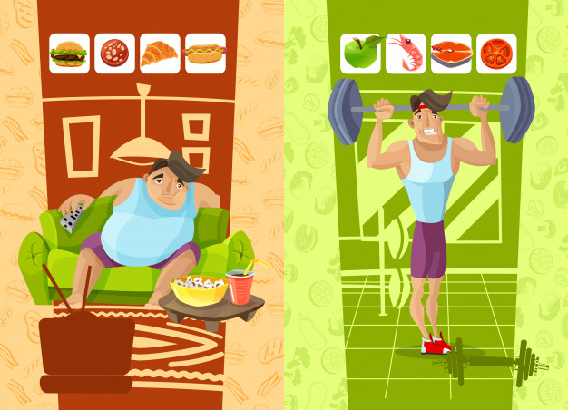
News words
5. healthy (adj) /ˈhel.θi/
# unhealthy (adj) /ʌnˈhel.θi/

Slide 10
News words
6. ill (adj) /ɪl/
→ E.g: You go to hospital if you’re ill.
# well (adj) /wel/ healthy, not ill

Slide 11
Vocabulary check

Slide 12
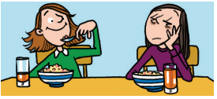
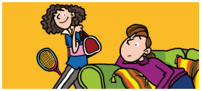
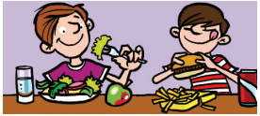
1. I’m OK today,
but my sister is very t _ _ _ _
c t i v e
2. Julie is very a _ _ _ _ _,
but her sister is l _ _ _.
i r e d
a z y
e a l t h y
3. Ollie eats h _ _ _ _ _ _ food, but
Martin eats u _ _ _ _ _ _ _ _ food.
n h e a l t h y

Slide 13
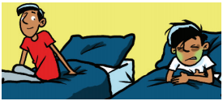
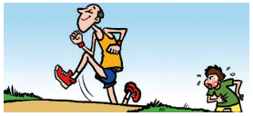
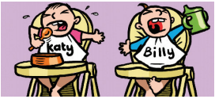
e l l
5. Oscar is u _ _ _ _, but his dad is very f _ _.
4. Murat is w _ _ _, but his brother is i _ _ today
n f i t
l l
i t
u n g r y
6. Katy is h _ _ _ _ _ , but Billy is thirsty.

Slide 14
Activity 2:
active –
2. hungry -
3. healthy –
4. fit -
lazy
full
unhealthy
unfit

Slide 15
Activity 3:
1. B. Don’t eat. Wait for dinner.
2. A. water
3. C. You aren’t well. Go home and go to bed.
4. C. really fit
5. A. Don’t go to bed late.
6. B. a person who is very lazy and stays on the sofa a lot

Slide 16

Activity 4:
1. Charlie:
2. Conor:
3. Fran:
a, b, h, c
b
f, g, d

Slide 17
Activity 5:
1. Eight or nine hours
2. No, he isn’t. He likes going out and doing sport.
3. He’s studying for exams.
4. She runs and swims.
5. Healthy foods: pasta, chicken;
Unhealthy foods: desserts and chocolate

Slide 18



Slide 19
Activity 6:
Questions | (you) | (your friend)
a. Do you think you’re active or lazy?
b. How many hours do you usually sleep?
c. Do you prefer sitting on the sofa or going out?
d. Do you usually eat healthy food?
e. What do you eat if you’re really hungry?
f. Do you like doing sports?
g. How far can you run
h. Are you lazy at weekends?

Slide 20
Homework
Learn by heart all new words.
- Workbook: Exercises page 38.

